Slide 1

APRN Workload Training
Created/Revised by Jim DelVero & Shawn Tipton-Hendershot WAC Comittie Members
Audience: Nursing at Michigan | Contact: L. Pelham | Reviewed: August 2023

Slide 2

Workload should adhere to contract language and not engage in renegotiating anything under mandatory subjects of bargaining.

Slide 3
Article 14-Highlights
ARTICLE 14 WORKLOAD REVIEW
133. When a problem of excessive workload arises, it must be addressed to ensure the long-term viability of the unit, including quality of patient care and employee satisfaction.
Workload Review Committee Resources
135. Members of unit workload review committees and the Association will be provided with education and information related to staffing and scheduling procedures, methodologies, considerations and tools, including available objective data.
136D. Additional Workload Review Committee responsibilities are described in Paragraphs 22A, 89, 131A.2-3, 158, 163A.1-4, 170D.2-3, 333H.2, 601E.

Slide 4
Article 14-Highlights Cont.
135B. Members of all workload review committees shall be granted access to existing and future data sources, repositories, and reports. In addition, at least monthly, the following will be provided for analysis: 1) Workload 2) Over appointment 3) Overtime 4) Assigned Time Off 5) Acuity and Activity trends 6) Anticipated and Unanticipated absences 7) Occupancy 8) Use of Agency Nurses 9) Any submitted Documentation of Practice Situation forms and any other relevant data 10) Position control and the unit budget 11) Use of professional development time. 12) UAP resources 13) Other relevant data that is available
135C. In addition to the items identified in para. 135B, Ambulatory Care workload review committees will have the following raw data and associated reports available for review 1) Past month’s patient visits 2) Phone volumes and associated defined metrics and Key Performance Indicators. 3) Productive and non-productive RN hours 4) Number of filled and vacant Licensed Practical Nurse and Medical Assistant hours 5) ACNRP and Decentralized float area staff usage and temporary and Per Diem nurse hours 6) Staffing plan including any benchmarks or budget information available 7) Other relevant data

Slide 5
Article 14 New APRN Contract Language
What this means is that our blended teams of PA/NP’s, who have historically been discouraged from having a workload, now are able to form a workload for the Nurse Practitioners!
Para. 134
h. A workload review committee will be convened in departments for nurse practitioners which may include other non-physician professionals credentialed to perform delegated medical functions.

Slide 6



Article 14 New APRN Contract Language Cont.
All OA/OT
Number of on call hours
Number of administration hours worked per calendar month for Advanced Practice Professionals (total and per individual)
Total number of daily encounters for Advanced Practice Professionals per 4-hour session on the unit
Total number of daily encounters per calendar month for Advanced Practice Professionals per billing code
Relevant productivity and workload data
Other relevant data as identified and requested
135E. In addition to the items identified in para 135B advanced practice workload review committees will have the following data available for review:

Slide 7

Membership on APRN Workload Committees
Term Length (2 Years per Term & 2 Terms total)
Starting a new committee!(half members need to serve 1- year and half 2-year terms)
Nominate a chair and co-chair at first meeting and workload members(not including supervisor) will vote for who enters chair and co-chair role.
WRC Should never have all members coming off.
Representation from all shift types on the Unit.
Diversity & Inclusion
Workload decisions will be made by consensus and with unit input. (i.e., Qualtrics surveys, email voting, survey monkey, ect…)Alter for what needs unit vote

Slide 8

Meetings and Release Time
Units will plan core staffing around WRC release time except in unusual & unintended patient care circumstances.
WRC will meet monthly.
WRC will determine monthly meeting times or more often to address workload concerns and formulate plans of action.
WRC will establish guidelines/processes to determine the necessity of a meeting and how the time/date is communicated to members.
Agendas will be posted 1 week in advance of the meeting to the whole unit. Meeting minutes need to be communicated to Unit within 72 hours and emailed to UMPNC @ UMPNCworkload@minurses.org
UMPNC representative will visit a workload meeting at least once a year.

Slide 9
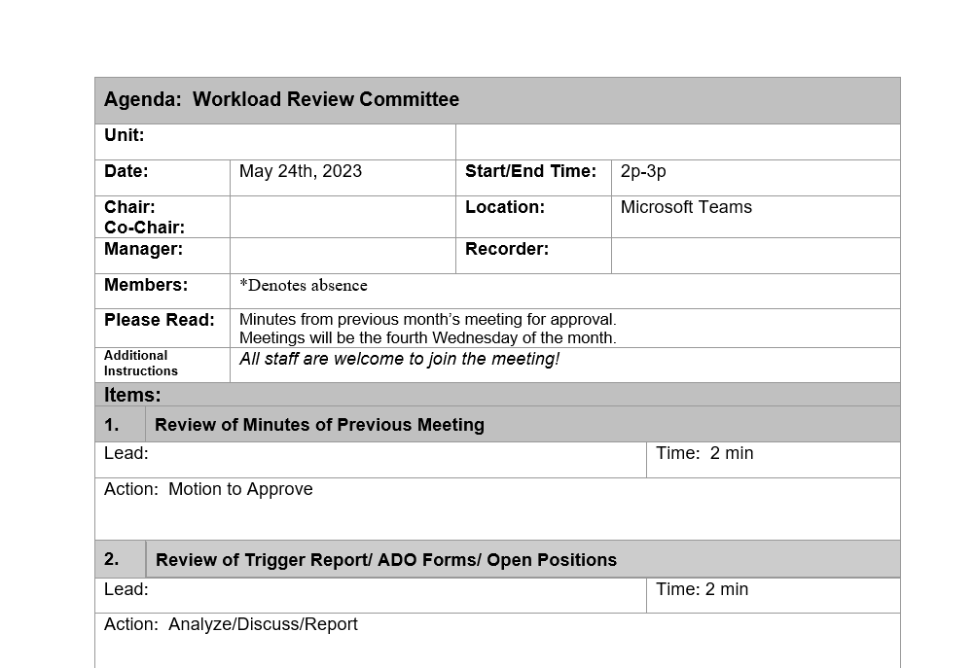
Agenda Example
https://www.med.umich.edu/NURSING/jit/forms.html

Slide 10

Creating Unit Guidelines
1st priority: Scheduling/Staffing Guidelines
OA/OT/ATO log Guidelines-NO MANDATORY OT!
PTO/Holiday Guidelines if applicable
Workflow Guidelines

Slide 11

Addressing ADOs
The Assignment Despite Objection Forms intent is to document an instance of unsafe working conditions that effects patient care to ensure further discussion at the unit level to prevent future occurrences.
Nurses Should not receive negative repercussions from filling them out.
All situations documented on ADO forms should be taken to workload for discussion, problem-solving and option generating to ensure prevention of further occurrences that jeopardize safety.
Please allow time for reading of the ADO/s as well as manager response/s. If the ADO/s is/are addressing an acute safety issue, please brainstorm ideas for addressing the issue and preventing it from reoccurring. If issues can be addressed on the unit by the unit supervisor/manager or unit staff, then plans should be implemented ASAP. If there is disagreement between members or manager or suggested solutions can not be completed on the unit then follow the following problem-solving workflow.
https://www.mna-umpnc.org/aprn-ado

Slide 12

Problem Solving
Workload & Management will work together to address unit workload issues.
1. If workload issue can be solved by supervisor, then the supervisor will implement that change on unit.
If issue cannot be solved at workload, please refer to para 137 for additional steps and request help from a UMPNC Rep with assistance if needed in this process.

Slide 13

PTO Rounds
Workload will meet to determine PTO hours that are offered up to the unit and how many hours are available during holiday weeks.(Management brings this number to WRC and goes over the number with WRC)
Employees may request up to 75% of annual accrual.
Requests are made for a period starting May 1 through April 30
February 1 – 21 First Request Period –Members can request up to 2 weeks off
By February 28, the Schedule is reposted after requests
March 1 – 14 Second Request Period
Final PTO Schedule Posted No Later Than April 1

Slide 14

VOTING!!!!!!!!!!!!!!!!
Try to be consistent in how you conduct a vote for the unit.
There are multiple ways to gather votes via Outlook(Poll), Qualtrics surveys, and in real time during the meeting by show of hands.
The main thing about voting is you MUST communicate results and attach results with meeting minutes to validate the vote that occurred and what the outcome of the vote determined for the unit.

Slide 15
VOTING Cont…….
Nominating Workload Chair and Co-Chair
During the first meeting take time to have self nomination or group/individual nominate Chair and Co-Chair positions to vote on.
Vote either by show of hands or via email during this meeting and elect Chair and Co-Chair.

Slide 16

Article 28 Workplace Changes
Please review for any proposed changes in the duties or responsibilities of a specific job.
This article has updated language for work redesign, workforce transition, unit reconfiguration, and pilot programs.
298A- Leadership and workload members will identify needs and notify the UMPNC president in writing.

Slide 17


Questions???????????????
UMPNC Phone is on 24/7 if you have any questions feel free to call:
Ph: 734-369-0260
https://www.mna-umpnc.org/reps

